Slide 1
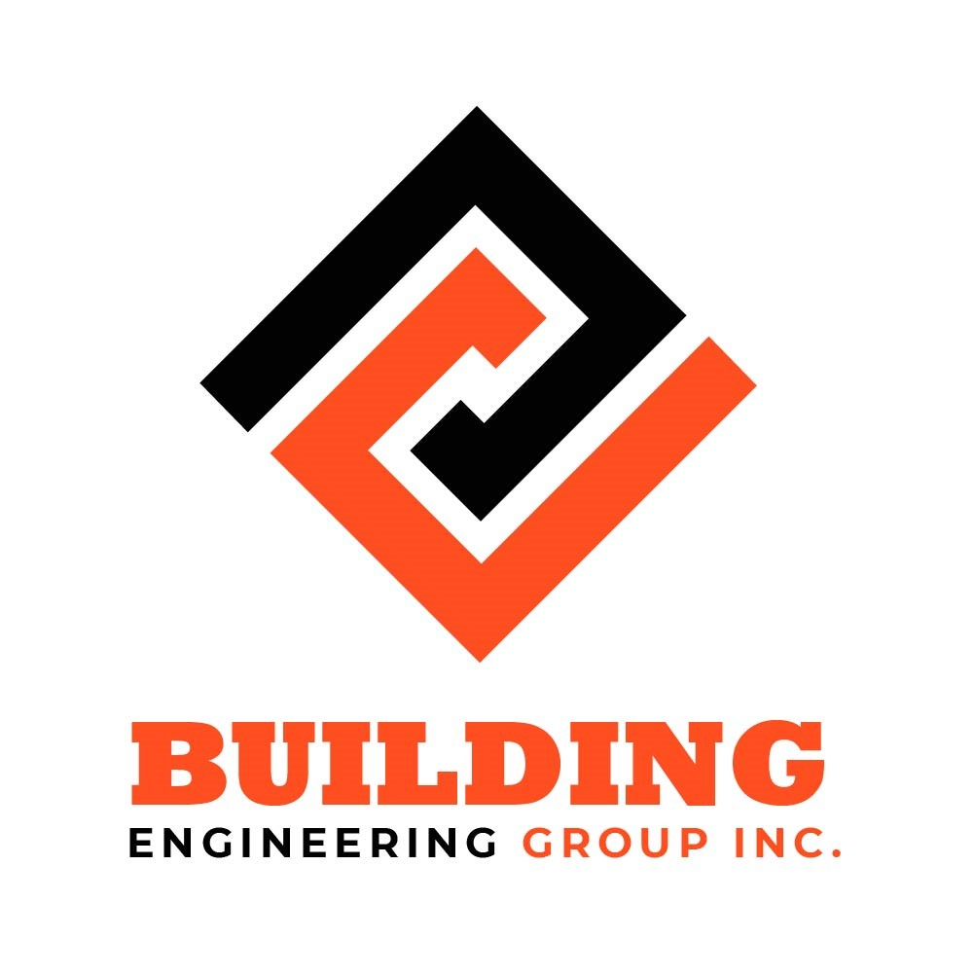

Slide 2
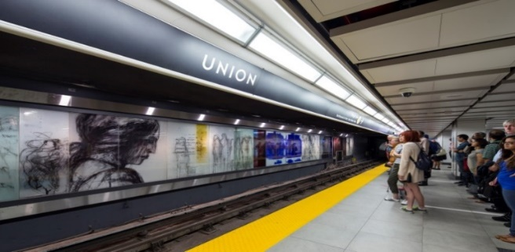
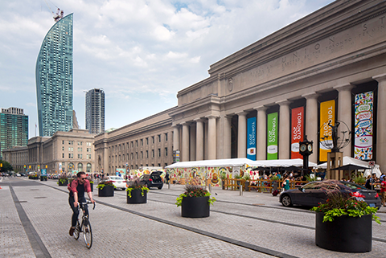
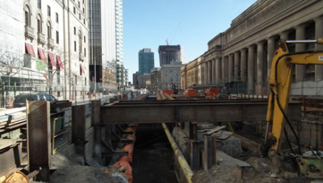
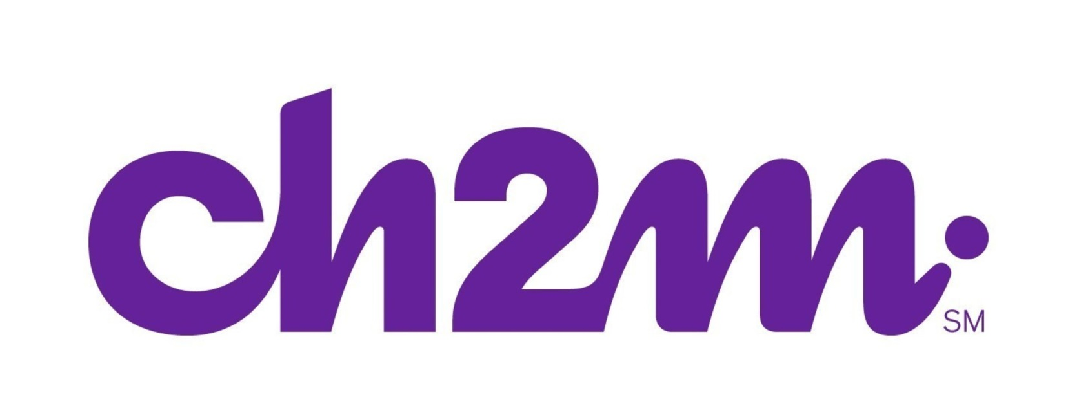
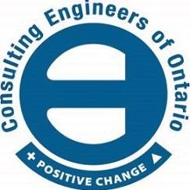
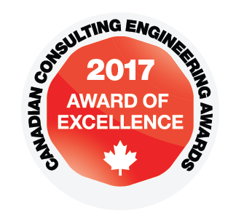
TTC, Union Subway Station Second Platform and Concourse Improvements, Toronto Date Completed: 2016 Total Value: $200 MM Owner: Toronto Transit Commission Contact Name: Silvano Florindi, P.Eng.
The project involved constructing a new south side platform for the Yonge subway line, an improved center platform for the University subway line and concourse improvements at Union Station. This required the staging of all train traffic , staging pedestrian and vehicular traffic flow on Front Street and Bay Street. Work also included the rehabilitation of the existing concourse and platform including the construction of a new automatic entrance. The construction of a new platform included earthworks, pile foundations, concrete and structural steel demolition. Reconstruction, flooring, glazing installation of an art wall, miscellaneous security, communication equipment and associated conduit/wiring, lighting fixtures, signage power, HVAC and plumbing was also included in the scope.
This project also included the construction of two new fire ventilation shafts, removal and reinstatement of the moat heritage wall, demolition and reconstruction of all service room surfaces. Further, the removal / relocation of all utilities (gas water sewer hydro, communication cables) within the construction zone, construction of a new siphon sewer at the Front Street east moat and the rerouting/ lowering and reconstruction of the existing sanitary sewer, removal/ modifications of the Harbourfront LRT, as well as strengthening of the north tunnel wall are also included. The scope of work also included the revitalization of the Front Street.
Winner of the 2016 The Willis Chipman Award from the Consulting Engineers of Ontario.
Winner of the 2016 .
Winner of Toronto Urban Design Award for Toronto Revitalization project.
Abbas was the Project Manager responsible for the overall delivery of the project and involved from inception to completion, including setting up the design and coordination of this multi discipline project team. Responsible for coordination and chairing of design and coordination meetings with stakeholders including; public and private utilities, Parks Canada (Heritage), Waterfront Toronto and Funding Partners.

Slide 3


Slide 4
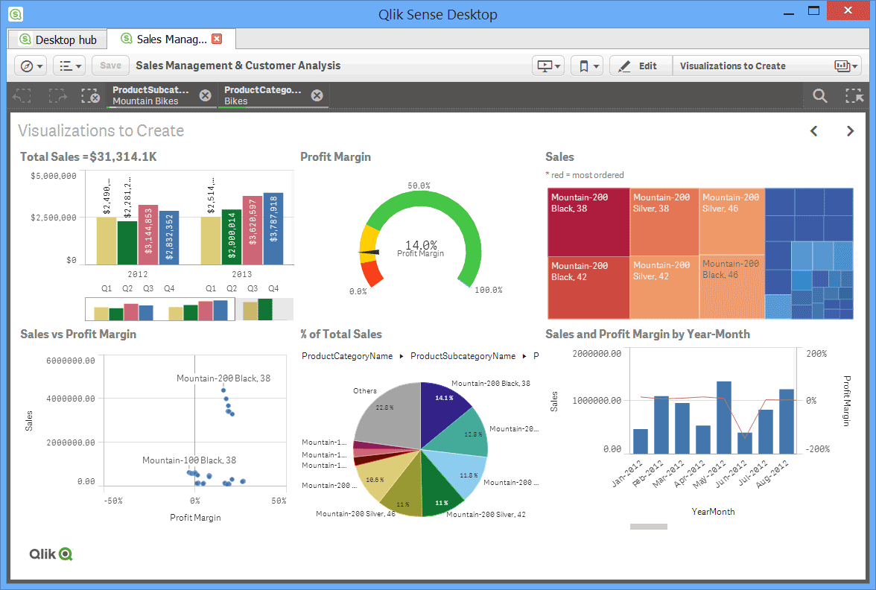
PMO & Growth Cities Initiative Date Completed: Ongoing Total Fees: $200,000 Client : LEA Consulting Ltd. Contact Name: Terry Wallace, P.Eng, President
Building Engineering Group led by Abbas Khayyam - P.Eng. was retained by LEA Consulting Ltd. in November 2019 to establish a PMO and help with developing a business case for growth opportunities in other Canadian Cities as part of their strategic initiatives.
The strategic objective of the PMO initiative is to improve efficiency and effectiveness of project delivery, while reducing costs, increasing the quality of deliverables and more effectively utilizing LEA’s resources to meet the clients’ requirements and expectations. The scope of services includes:
Establishment of an enterprise wide PMO, creation of associated policies and procedures;
Development of the company Quality Management System (QMS);
Establishment of standardized project reports with appropriate and actionable KPIs by PMs;
Staff training and implementation of the new procedures and policies;
Project Manager mentoring and support;
Acting as the SME in business development and project work.

Slide 5
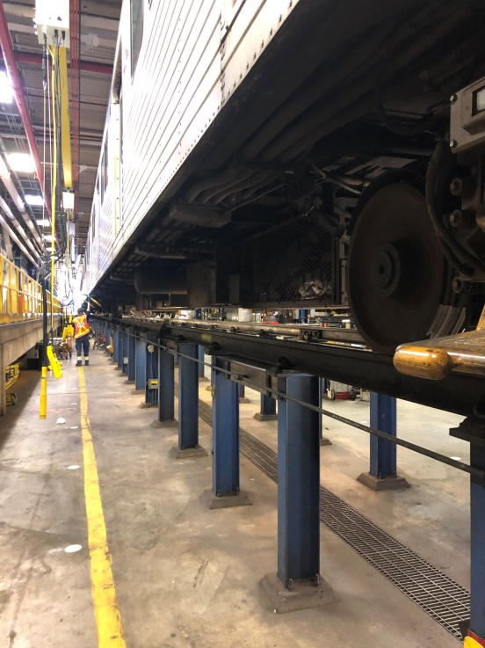
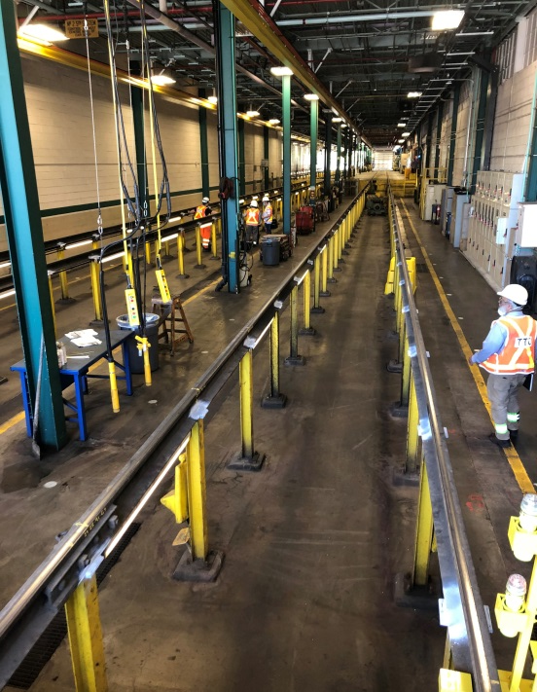
TTC Maintenance Engineering- Subway Infrastructure Date Completed: Ongoing Total Fees: $800,000 Client : Toronto Transit Commission/LEA Consulting Ltd. Contact Name: Shahe Sagharian, P.Eng, Vice President
TTC has retained the services of our consulting team over the next 5 years to provide track and structure engineering support, track maintenance and track design expertise for the Subway and SRT transit lines. Abbas is the Project Manager for the multi-discipline team responsible for the delivery of the program and providing the following services :
Engineering Support Services
Design, analysis, and assessment of track substructures, special track work (switches, turnouts and expansion joints) and track fasteners
Design analysis and guidance in maintenance of track drainage, guidance in rehab of drainage components;
Track Asset Management and Life cycle of track and track components;
Perform conditional survey and determine the causes of deterioration and provide recommendations.
Research and Development
Thermal analysis of rail and track structures to assess risk of track buckling and pull apart and/or misalignment and propose solutions;
Review, research, and development of track maintenance and track construction standards i.e. rail wear, track trackbed capacity/durability, and track geometry tolerances;
R&D of Subway and Surface track noise and vibration attenuation and mitigation industry practices.
Testing Facilities and Services
Climate Chamber Testing;
Cyclic Load Testing;
Vibration Testing;
Strength and Deflection Testing.

Slide 6
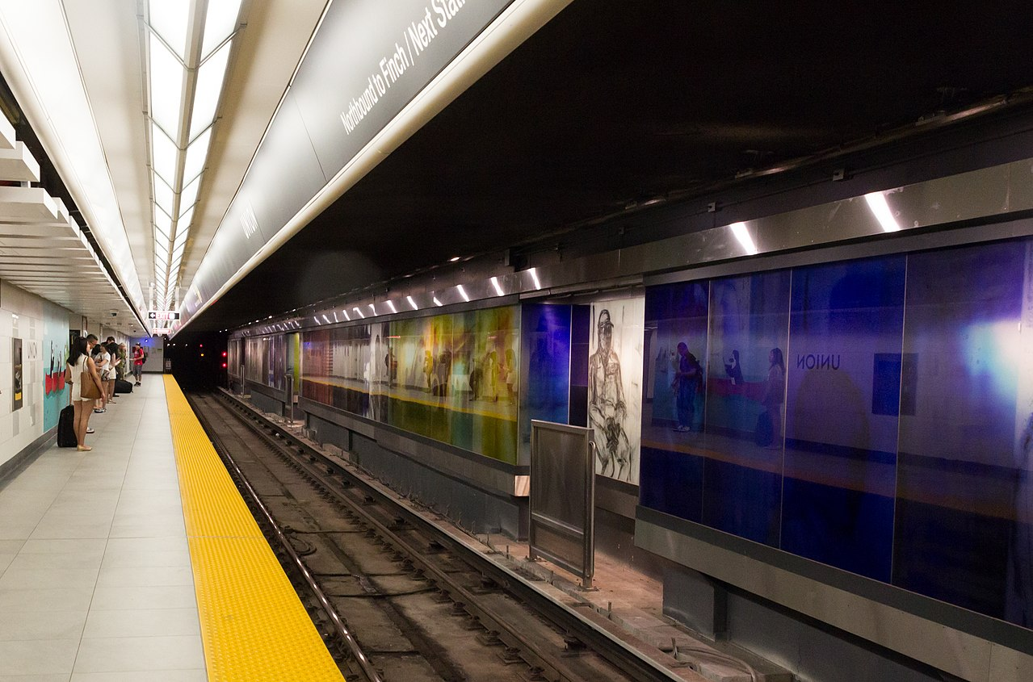

Slide 9
